Slide 1
Unsupervised Detection of Intrusions Based on Clustered Network Flows - Final
By Chandler Silk and Travian Lenox

Slide 2
Refresher: Problem
Signature-based systems miss novel threats
Simply detecting that an anomaly exists does not identify it as an attack
  Therefore, blocking all anomalous connections would block legitimate connection attempts
UNSW-NB15 is a large, highly defined dataset that is not fully representative of a personal experience
For smaller networks, false positives can be even more harmful
Notes:
So a quick little refresher on what the problem is
First, signature based systems often miss zero day threats, these are threats that arent yet known to the developers.
Second we cant simply block all connections that are against the norm, some might be legitimate connection attempts.
Third UNSW’s data set is large, however its entirely office network connects
Which leads into reason 4, smaller networks with a wider variety of network connections might trigger false positives. Not ideal,

Slide 3
Refresher: What we did last time
Preprocessor
PCA
HDBSCAN
Output Graphs
Notes:
As for what we went over for our previous update,
We started with a pre processor to bring the column count down from 49 to a more manageable size, and then ran the data through a PCA to further refine our models data
After doing such we then ran it through HDBSCAN to get the clusters
As well as turned the HDBSCAN output into a graph so we could visualize the clusters.

Slide 4
Dataset
Why this set?
Modern Network Traffic
  Uses real network traffic
  Mixes in synthetic modern attacks
Gold Standard
  49 Features (Source + Destination)
  9 attack patterns
  Realistic balance
How it helps
  High Dimensionality
UNSW-NB15 CSV files
Notes:
The dataset we used is UNSW’s NB15 dataset. Hasn’t changed since the update
Has modern network traffic used from real office networks, and a mix of synthetic attacks built in
That’s not what makes it considered a gold standard, as it also includes 49 features of network data. And 9 attack patterns. despite these datasets massive size it mixes in a realistic amount of attacks into the normal network traffic
This dataset helps our model with its high dimensionality. We can check and see exactly which parts of the network data are most important for detecting anomalies.

Slide 5
Preprocessing
Janitor Phase
  Ensure every row is complete and labels are clean
Log Transformer
  Gives the same weight to large and small traffic
Context Builder
  Creates ratios of certain network components for comparison later
Translator
  Converts text like TCP or HTTP codes into numbers
Auditor
  Removes unnecessary columns
Notes:
For our preprocessing process
We split it up into 5 phases
First is the Janitor Phase, This phase ensures every row is complete and labels are clean, as mentioned the UNSW dataset labels attacks so making sure our model had no labels is necessary
Next is the log transformer, some of the rows are filled with extremely large transfer packets but they arent attacks. So the point of this phase is to scale down the larger data points to give them a similar weight to the smaller ones. This allows for the large transfers to not be flagged.
The context builder creates ratios of certain network columns, as a download of 10mb and an attack of 10mb looks the same if you only look at the byte count, so by creating ratios of certain columns you get a density so to speak of these packets. This then allows for better comparison between packets
The translator is pretty simple, protocols are letters, pca only works with numbers, so the translator convert the protocol codes to numbers so PCA math actually works on them.
Lastly we have the auditor, this checks columns and deletes rows with zero variance, and normalizes the rest of the data before send it to the PCA

Slide 6
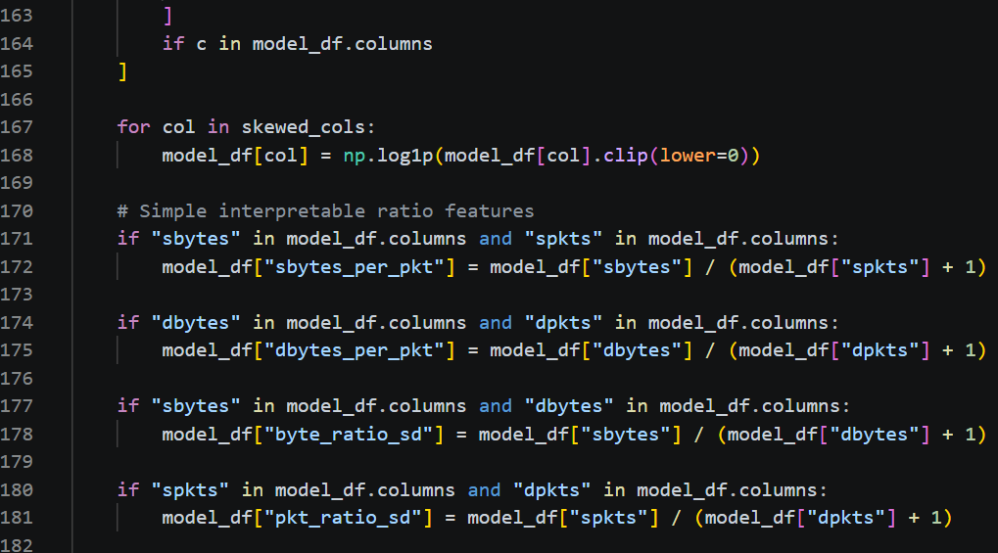
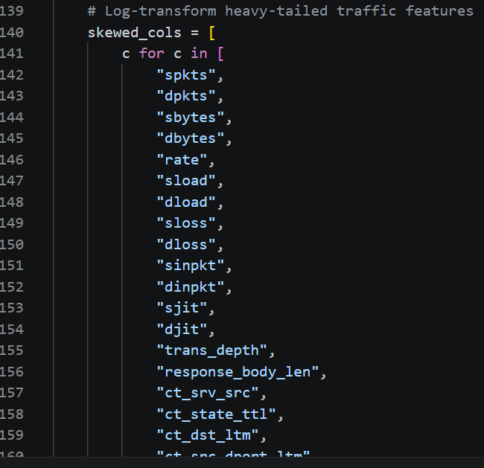
Preprocessing Code

Slide 7
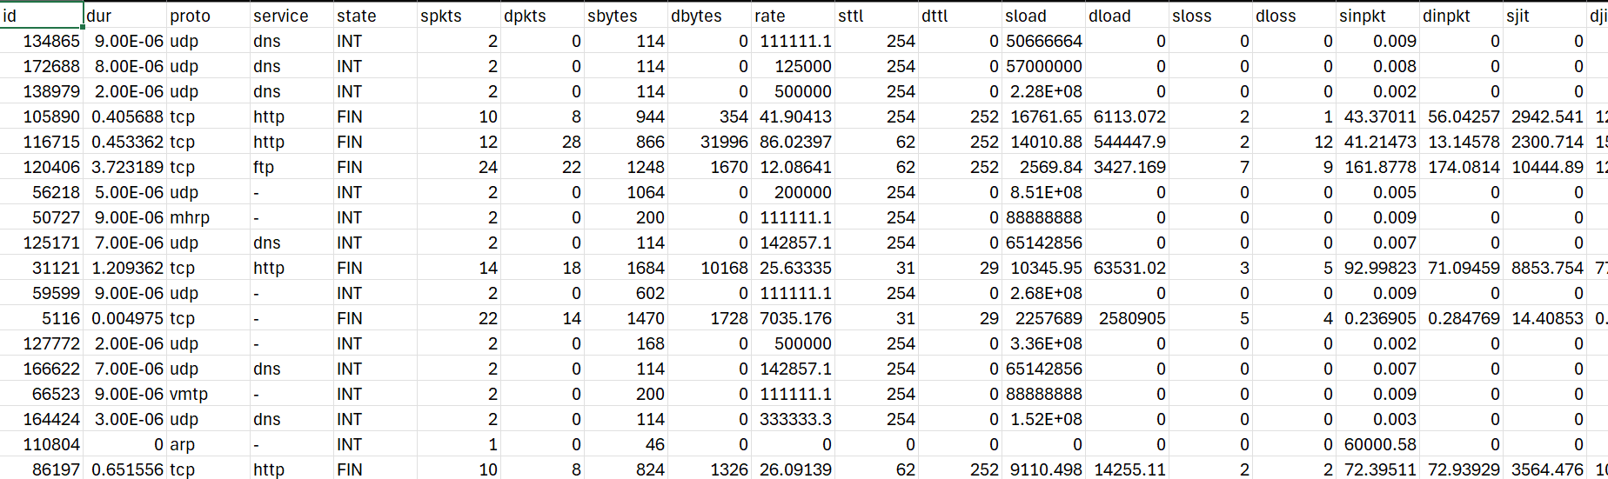
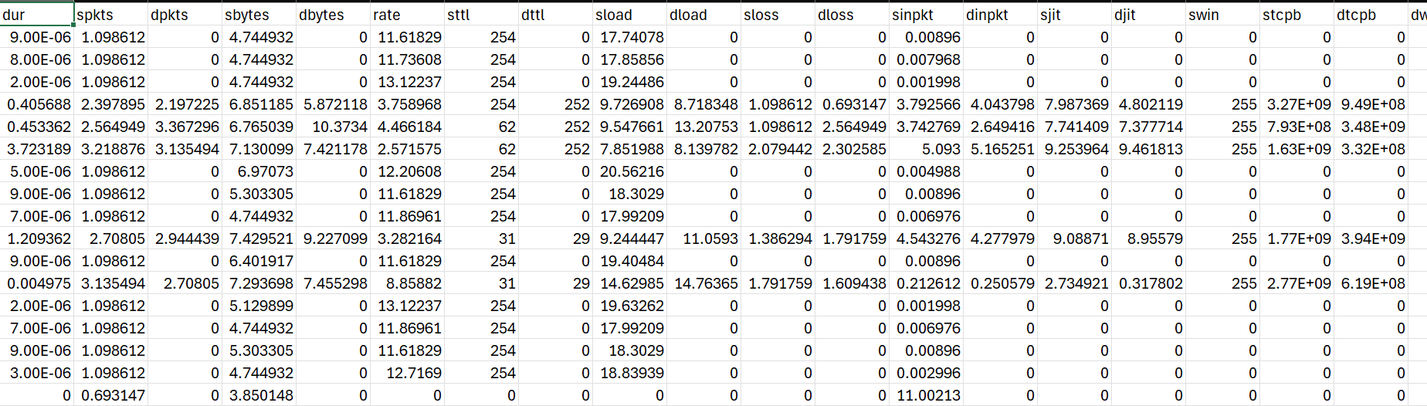
Preprocessing Results
Notes:
On the top we have the raw input. It’s a messy mix of text labels like 'TCP' and 'DNS' that math can’t process, and columns like 'sload' where values are in the millions. In this state, the AI is blinded by scale—it would flag any high-volume connection as an anomaly simply because the number is big.
On the bottom you see the result of our pipeline. We’ve removed the irrelevant 'id' field, encoded the text into numbers, and used log-transformation to 'squash' those millions down into a balanced range. By leveling the playing field this way, we stop the model from being distracted by raw size and allow it to focus on actual behavioral patterns. This transformation is the foundation that allows our clustering to achieve its high accuracy.

Slide 8
What We’ve Done Since
Added the Isolation Forest Algorithm to detect anomalies
Used HDBSCAN and IF in conjunction to boost anomaly detection confidence
Made human-readable reports simpler to read and more clear in its analysis
Phase 2

Slide 9
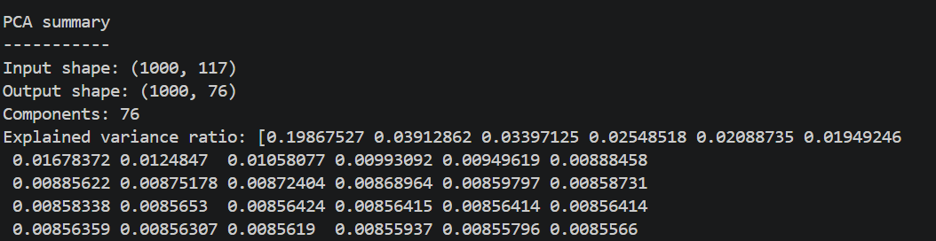
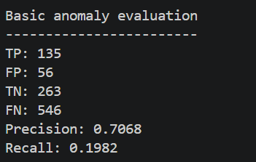
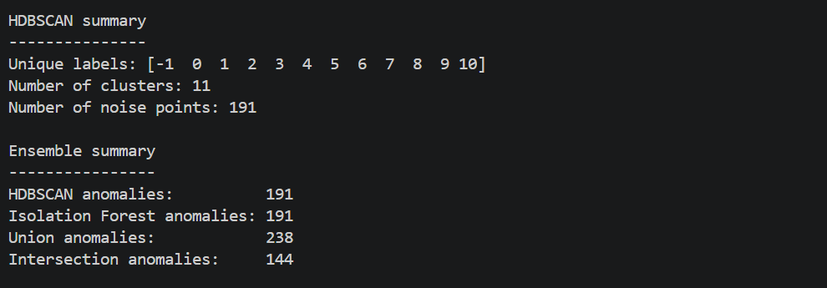
Finished Outputs

Slide 10
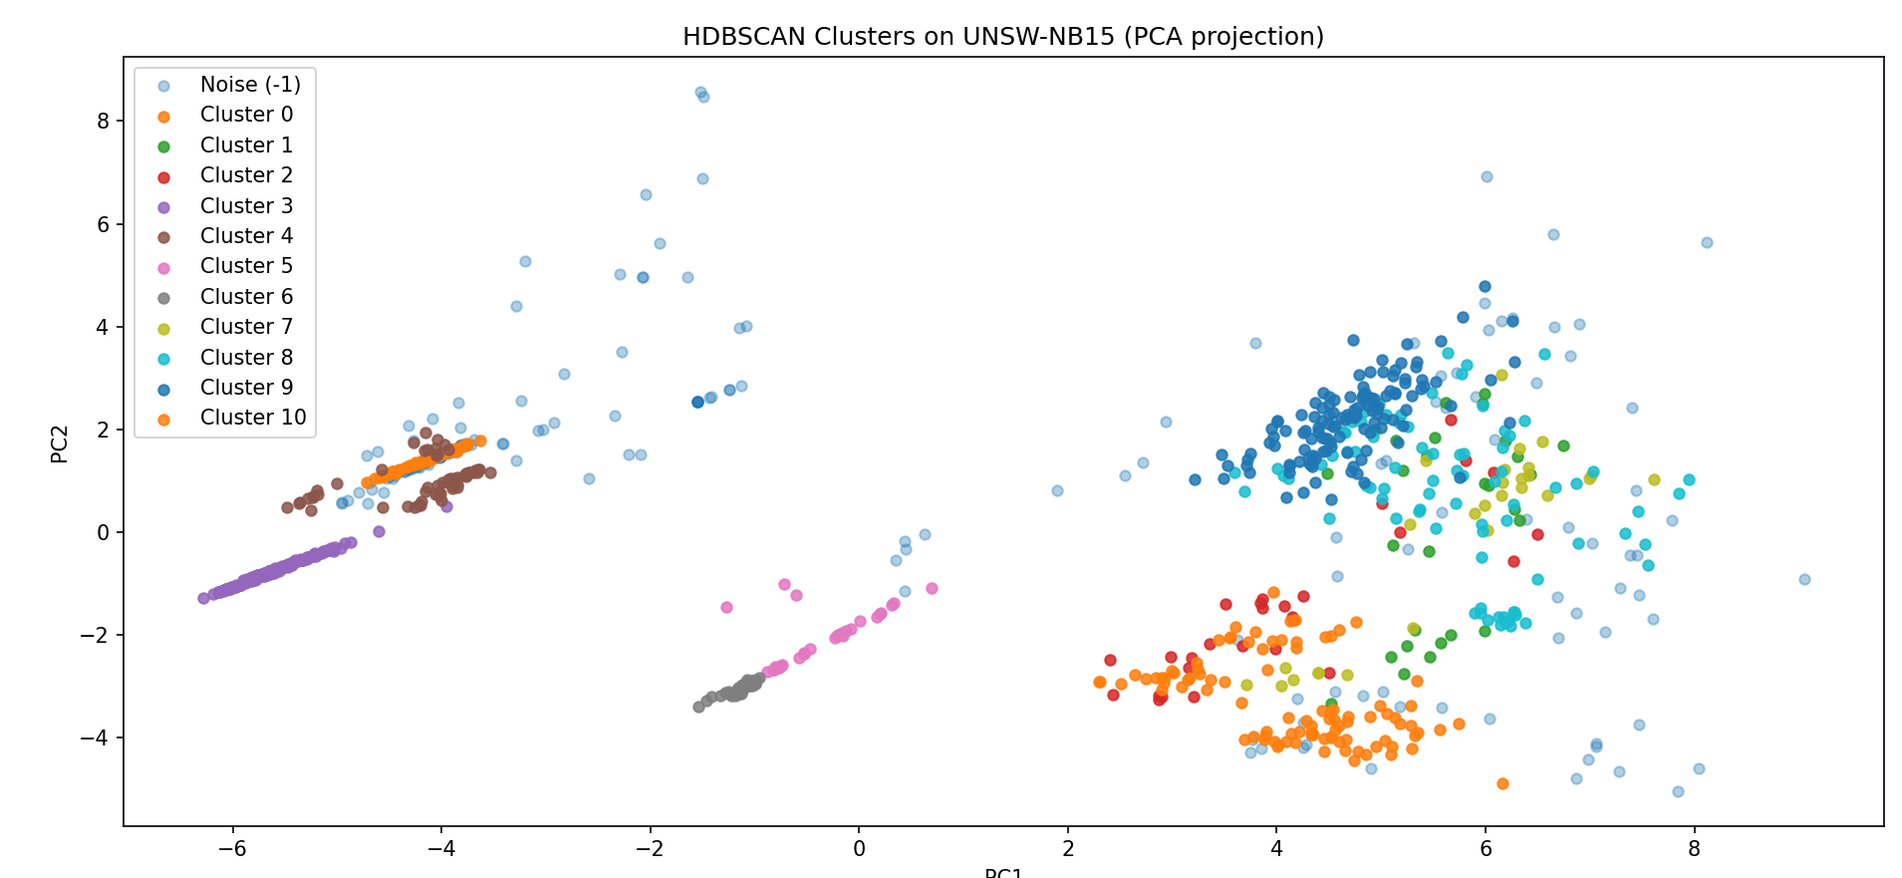
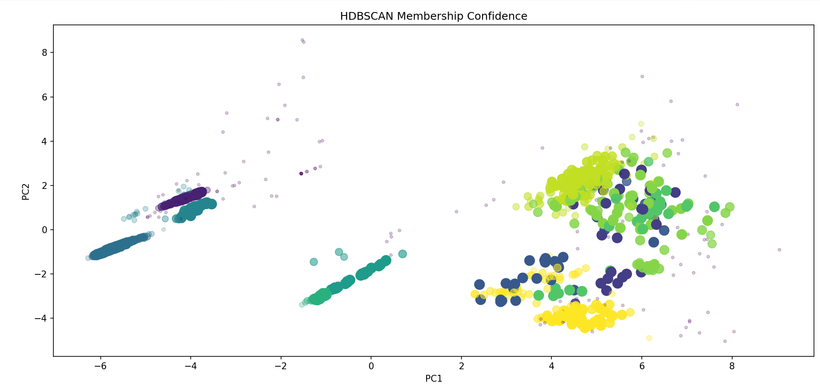
Results

Slide 11
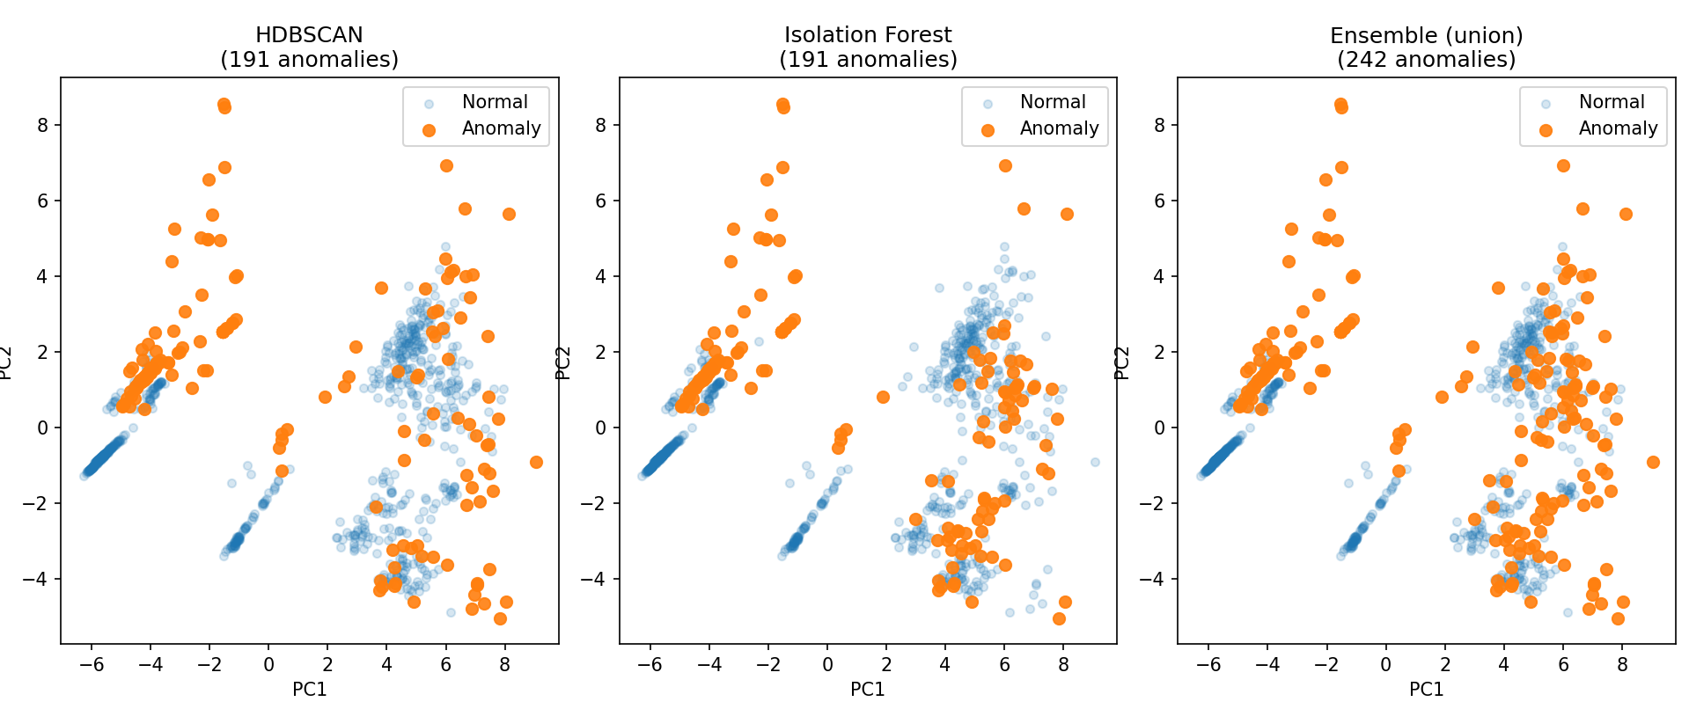
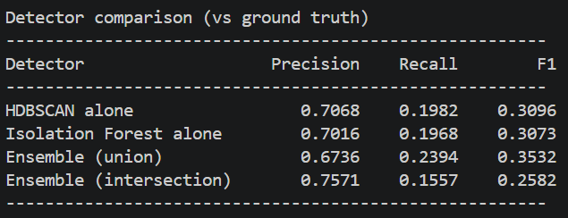
Using HDBSCAN and Isolated Forest Together

Slide 12
Bonus Work
What We Proposed
What We Did Extra
Why It Matters
Use PCA and HDBSCAN in conjunction to identify outliers, and rank the top outliers.
While PCA, HDBSCAN, and now IF detect the anomalies, we analyze the anomalies’ behavior in order to identify the likelihood an anomaly is an attack, and what type of attack it could be.
Someone can upload captured traffic data from their own network and receive an analysis on the anomalies and potential threats in an organized, readable report.

Slide 13
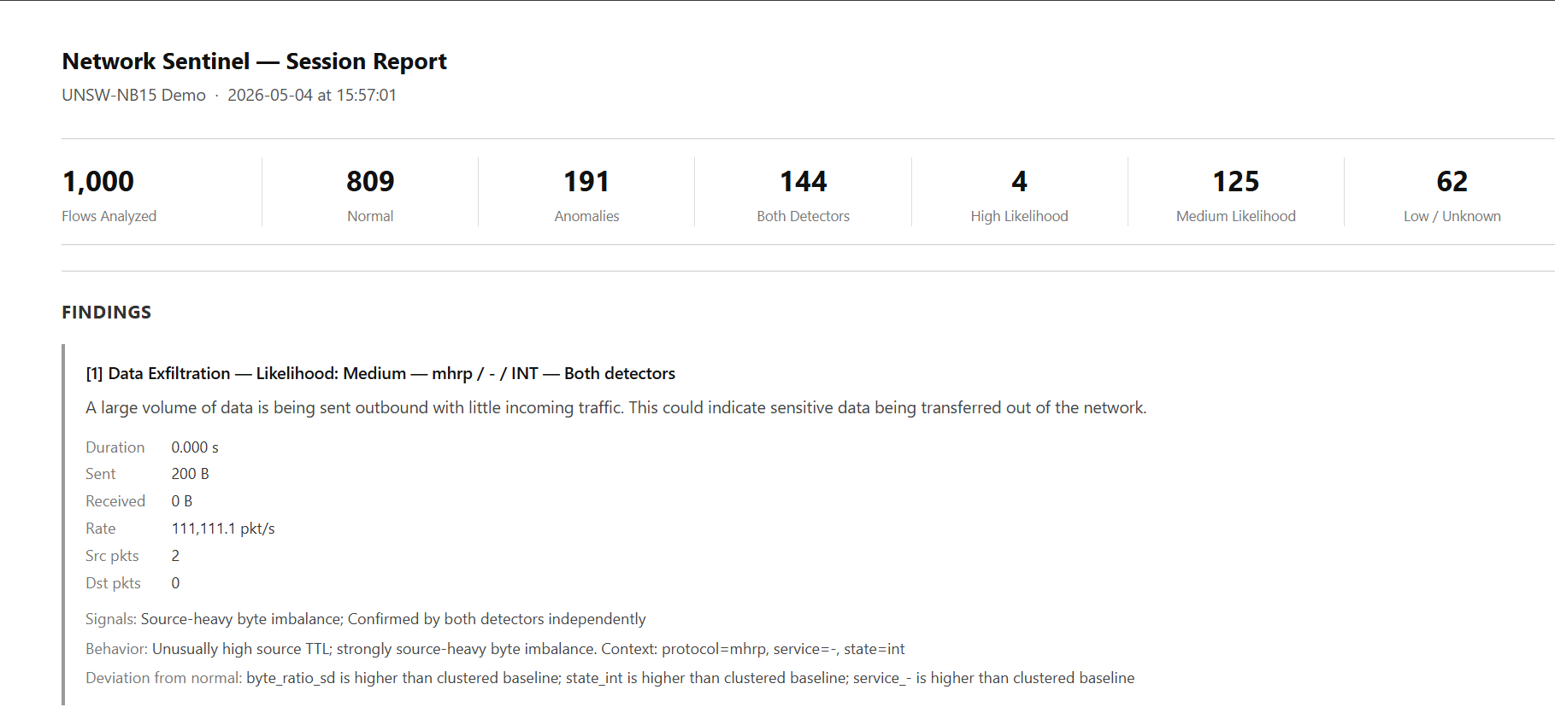
Anomaly Report

Slide 14
Discussion of Results
Utilizing both HDBSCAN and IF boosts confidence in the methods ability to identify anomalies
  Both algorithms are lightweight and easily deployable on a Raspberry Pi for use on a home network
Giving a user a readable report makes analyzing the method’s findings easier
Potential Issues: Results may not generalize to full traffic volume

Slide 15
GitHub Links
https://github.com/Ashfter/CS472_Final_Project
https://ashfter.github.io/CS472_Final_Project

Slide 16
Thank You!

